Slide 1
Fake News Detection System
Project Group Number 07
DVS Sravan (AM.EN.U4CSE19117)
Dutta Sai Tharun (AM.EN.U4CSE19119)
G. Vidyacharan Varma (AM.EN.U4CSE19120)
Seelam Ram Mohan Reddy (AM.EN.U4CSE19150)
Sai Ganesh Chepuri (AM.EN.U4CSE19166)

Slide 2
BACKGROUND:
Everyone relies on numerous online resources for news in our modern era, where the
internet is ubiquitous. As the use of social media platforms such as Facebook, Twitter, and others has grown, news has travelled quickly among millions of users in a short period of time. The propagation of fake news has far-reaching repercussions, from altering election outcomes in favor of specific politicians to creating prejudiced viewpoints. Furthermore, spammers utilize appealing news headlines to make cash through clickbait adverts.
With the use of Machine Learning techniques, we hope to conduct binary categorization of various news items available online in this project.

Slide 3
PROBLEM STATEMENT:
Designing a fake news classifier using various machine learning algorithms.
We want to build a system that can classify the given input of news as Fake or not. The task here is to predict news based on the trained data and classify the results. It is a binary classification problem with 2 different classes(Fake News(1) and Real News(0)).
There are numerous methods for Text Preprocessing but, for this we have decided to use Stemming and Vectorizing methods to convert the data to the required format.

Slide 4
ALGORITHMS USED:
Logistic Regression
KNN classifier - K Nearest Neighbors
SVM classifier - Support Vector Machine
Decision Tree classifier

Slide 5
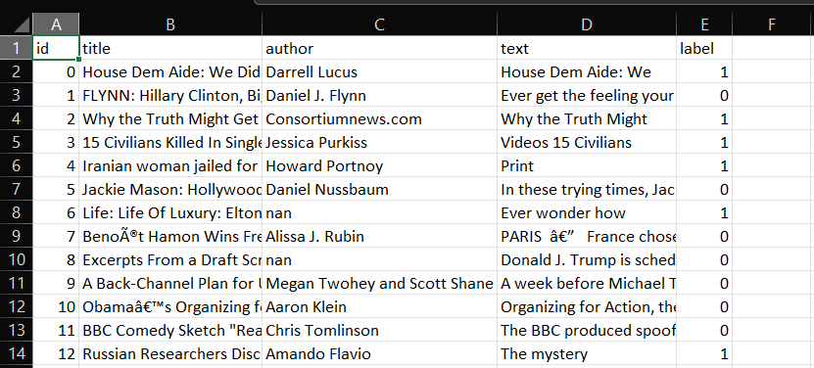
About the Dataset:
1. id: unique id for a news article
2. title: the title of a news article
3. author: author of the news article
4. text: the text of the article; could be incomplete
5. label: a label that marks whether the news article is real or fake:
1: Fake news
0: real News

Slide 6
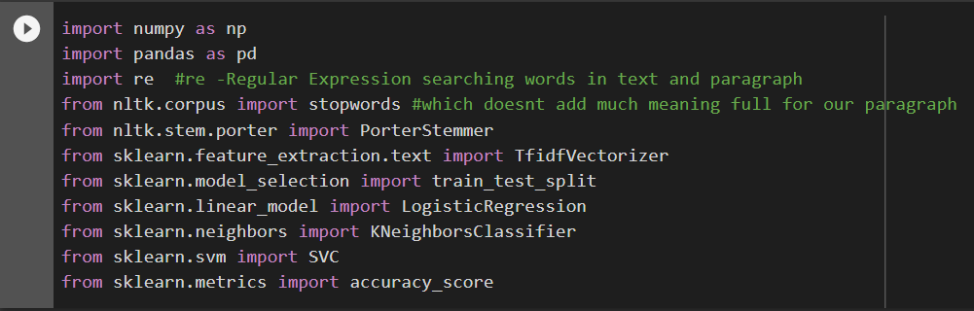
Dependencies Required

Slide 7
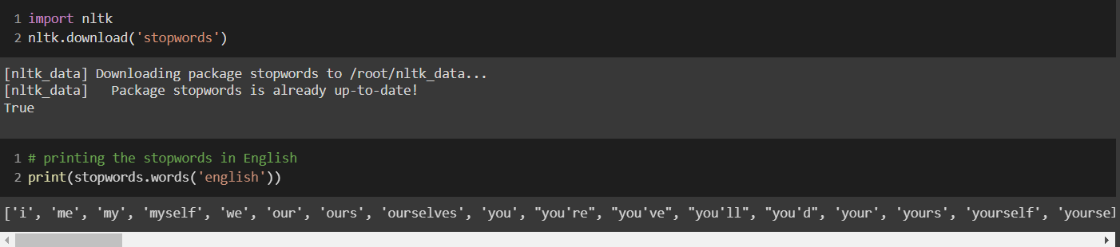
STOPWORDS:
The words which are generally filtered out before processing a natural language are called stop words. These are actually the most common words in any language (like articles, prepositions, pronouns, conjunctions, etc) and does not add much information to the text. Examples of a few stop words in English are “the”, “a”, “an”, “so”, “what”.

Slide 8
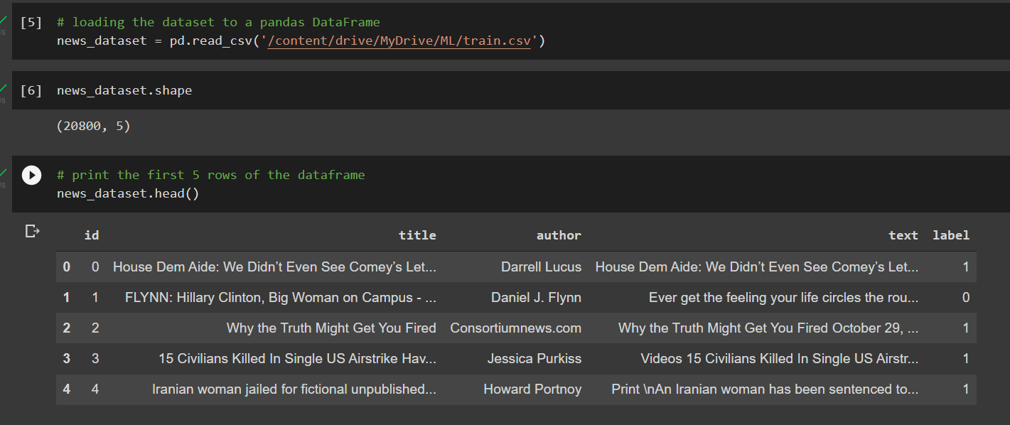
Here we are using data sets from Sklearn we had downloaded and with the help read_csv function we are importing the data and next line we can see shape of the data set
With the help of head function we can see first 5 data rows of our data.

Slide 9
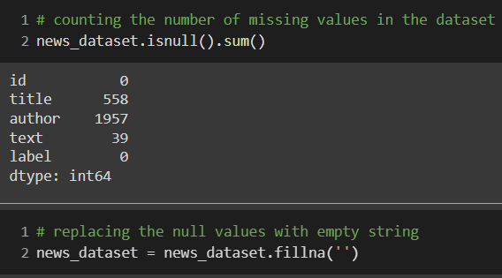
news_dataset.isnull().sum()
is used to count the number of missing values in the dataset.
There are
0 null values in id,
558 null values in title,
1957 null values in author,
39 null values in text and
0 null values in label.
We replace the null values with empty string using,
news_dataset = news_dataset.fillna(‘’)

Slide 10
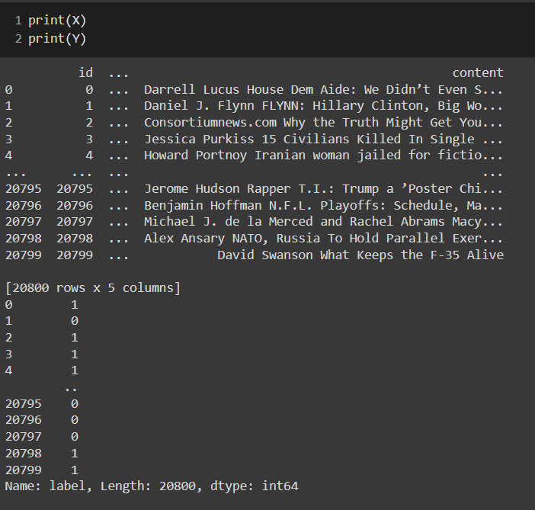
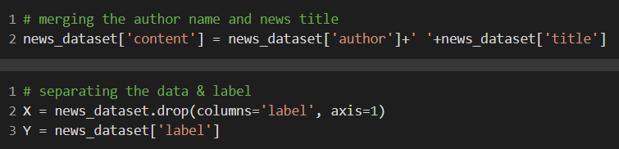
MERGING THE COLUMNS author and title to content:
Here we are taking another column content and merging author and title together and making single column.
In second screen shot we are printing x we can see author and text are combined. Printing y we can see only label is printing which indicates 0 and 1.

Slide 11
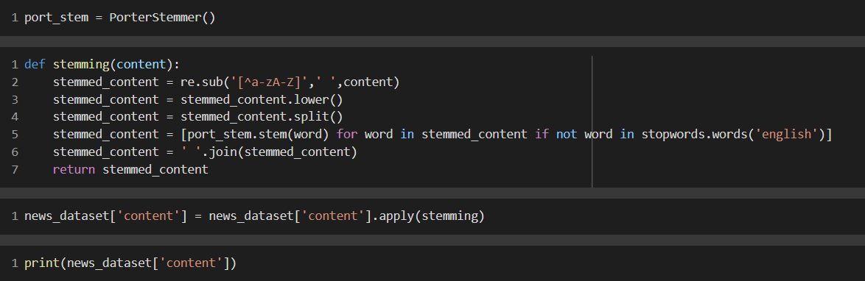
STEMMING:
Stemming is the process of reducing a word to its Root word.
example:
actor, actress, acting --> act

Slide 12
STEMMING:
stemmed_content = re.sub('[^a-zA-Z]',' ',content)
Make the content only with alphabets, i.e., a-z and A-Z. Remove numericals and special characters.
stemmed_content = stemmed_content.lower()
Convert the data to lowercase, i.e., a-z
stemmed_content = stemmed_content.split()
Split the data so that it becomes a list
stemmed_content = [port_stem.stem(word) for word in stemmed_content if not word in stopwords.words('english')]
Apply stemming to every word other than the words in stopwords.
stemmed_content = ' '.join(stemmed_content)
Joining the processed data with ‘ ‘ separator.

Slide 13
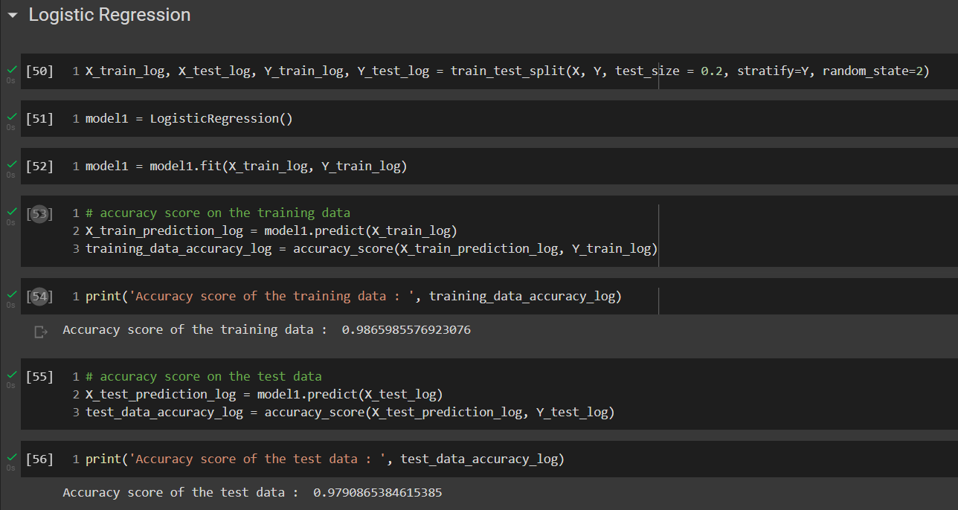
TEAM MEMBER-1 : Seelam Ram Mohan Reddy, AM.EN.U4CSE19150.
I have implemented the fake news detector algorithm using Logistic Regression classifier.
Colab Notebook File: Click here
Firstly, Logistic Regression algorithm and accuracy score were imported from sklearn and and then splitting the data for training and testing purposes.
Here, I have split the data into 20% for testing and remaining 80% data is for training.
Now, implementing Logistic Regression algorithm was done on the training data. With help of fit function, fitting was done for x_train and y_train.
Using predict function, predicting was done on x_test.
Using Accuracy_Score we know how accurate is our model on our test data.
Logistic Regression
Accuracy Score training data - 98.65%
Accuracy Score test data - 97.90%

Slide 14
TESTING:
Here we are testing the model with data that we made using train_test_split algorithm.
We have 20% of the overall data as testing data.
So, we manually test the model with the test data.
So we create a new variable X_new_log and assign to any random datapoint in the test data.
So to verify if the X_test predicted value is correct, we check the predicted value in the Y_test with the output of X_test.
By comparing these, we can verify the output.

Slide 15
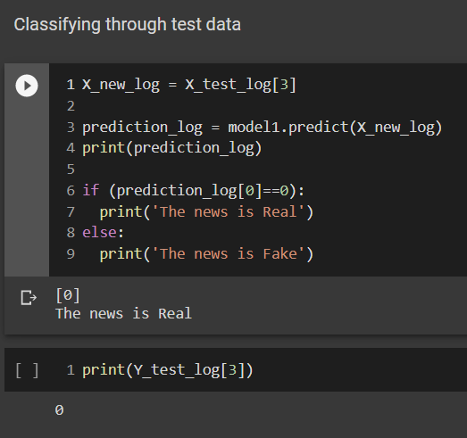
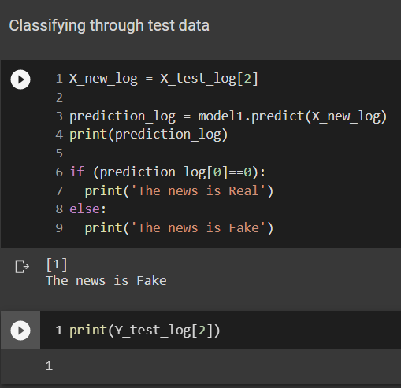
Real News: Fake News:

Slide 16
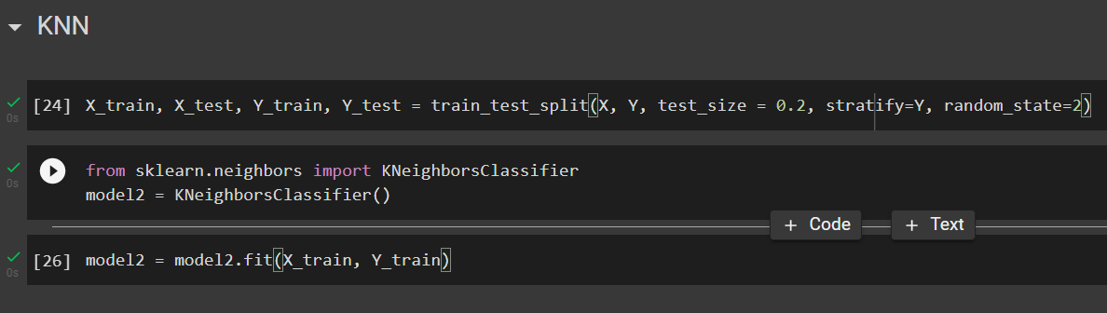
TEAM MEMBER-2: Sai Ganesh Chepuri, AM.EN.U4CSE19166.
I have implemented the Fake News Detection using KNN(K - Nearest Neighbours) Algorithm.
In the above the screen shot we can see we are implementing KNN (K Nearest Neighbours) algorithm first we are dividing the our data into train and test and taking 0.2% of data for testing and remaining data for training.
With help Sklearn we are importing KNeighbourClassifier and implementing KNN algorithm on our model.
With help of fit function we are fitting X_train and Y_train in KNN.

Slide 17
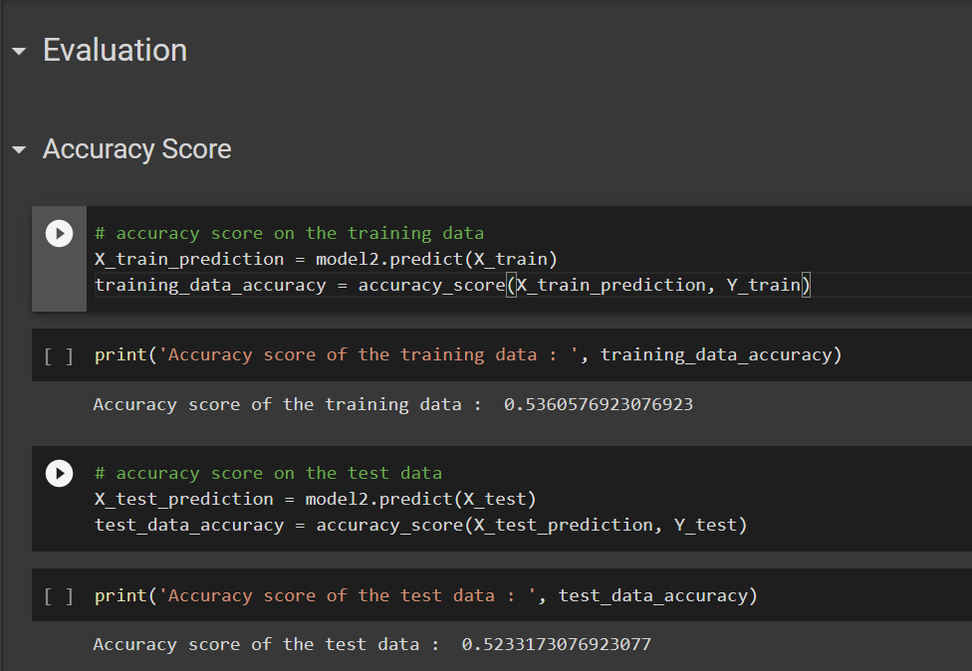
Here we are using accuracy score which is used to find how accurate is our model on our data.
First we have to predict our x_train data on KNN and store the result in X_Train_Prediction.
With help of accuracy function i am finding how accurate is our model on our train data.
So we can see Accuracy on our training data is 53%
Again using accuracy function to predict how accurate is testing data on y_test.
So we can see Accuracy on our training data is 52%
So by this we can understand KNN is not showing good accuracy for our data.

Slide 18
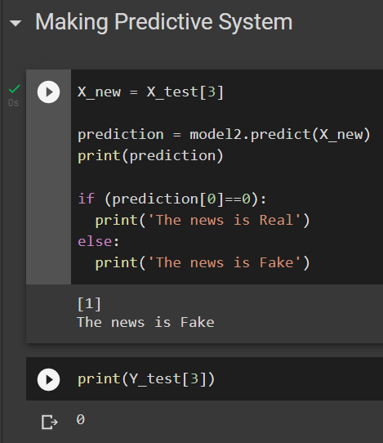
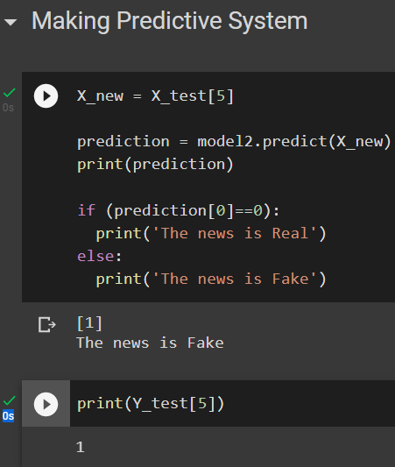
Real News
Fake News

Slide 19
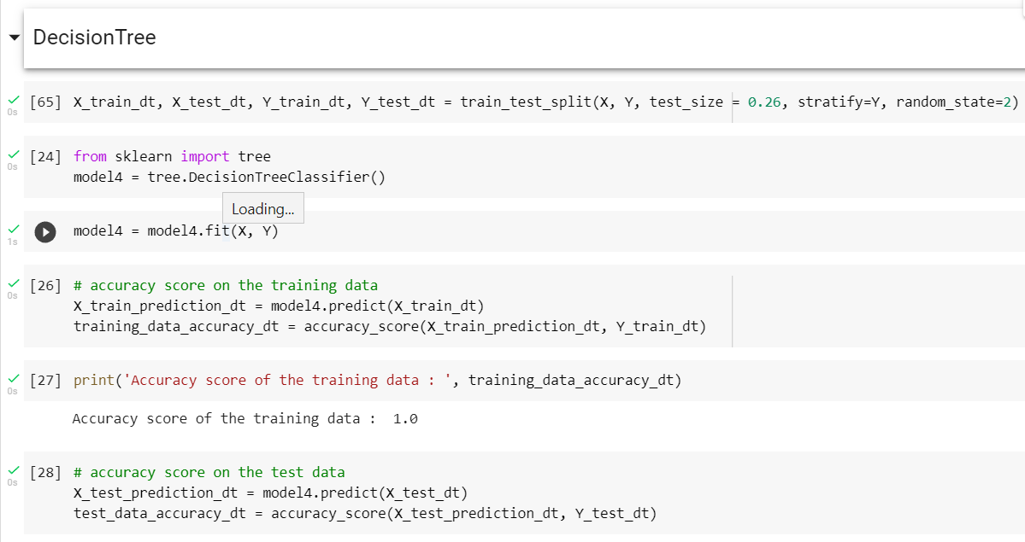
Decision Tree :
Vidya charan Varma, AM.EN.U4CSE19120.
D.V.S.Sravan, AM.EN.U4CSE19117.
The data was separated for training and testing after importing the Decision Tree method and accuracy score from sklearn.
I've divided the data into two sections: 20% for testing and the remaining 80% for training.
The training data was used to create the Decision Tree. Fitting for x train and y train was done with the aid of the fit function.
predicting was done on x_test, by using predict function.
We can determine how accurate our model is on our test data by using Accuracy Score.

Slide 20
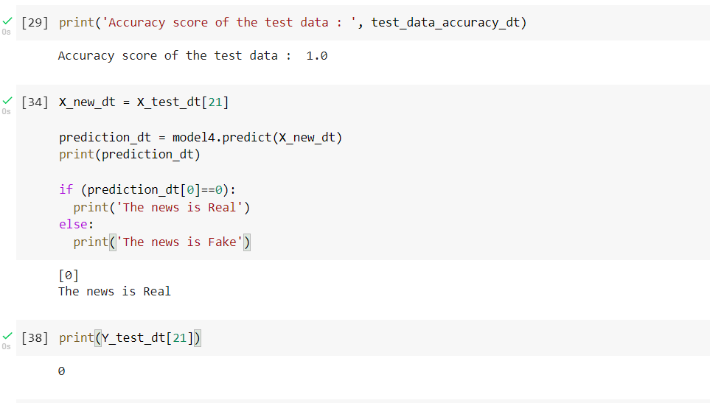
Decision Tree
Accuracy Score training data - 100%
Accuracy Score test data - 100%

Slide 21
TESTING :
We're putting the model to the test with data generated by the train test split technique.
We have 20% of the total data set as testing data.So, With the test data, we manually test the model.
As a result, we establish a new variable called X_new_log, which we may assign to any random datapoint in the test data.
To see if the X_test predicted value is right, we compare the Y_test anticipated value to the X_test result.
we can verify the output by comparing these.

Slide 22
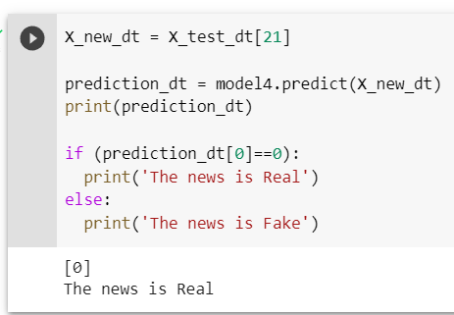
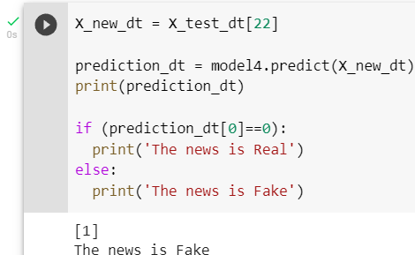
Fake news :
Real news :

Slide 23
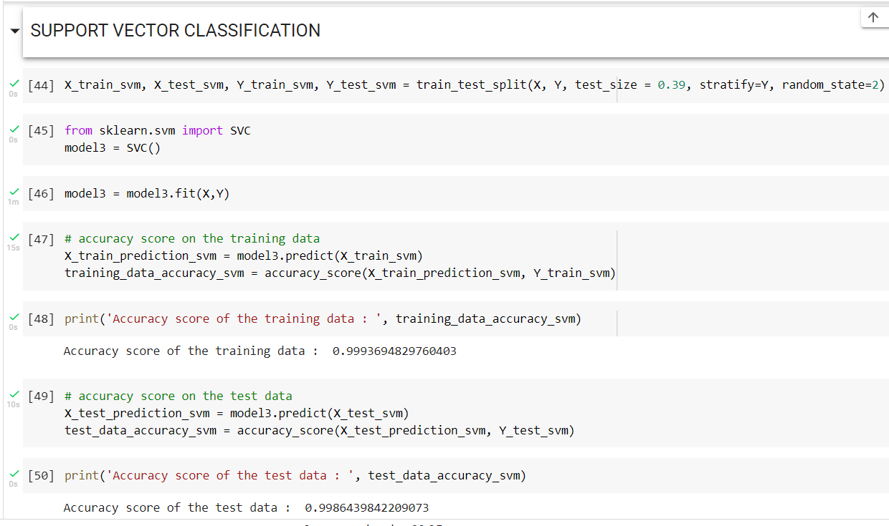
TEAM MEMBER-5: DUTTA SAI TARUN, AM.EN.U4CSE19119.
I have implemented the Fake news prediction algorithm using support vector classification.
.
Firstly, Decision Tree algorithm and accuracy score were imported from sklearn and and then splitting the data was done for training and testing purposes.
The accuracy of the training data is 99% and the accuracy score of the test data is 99%.

Slide 24
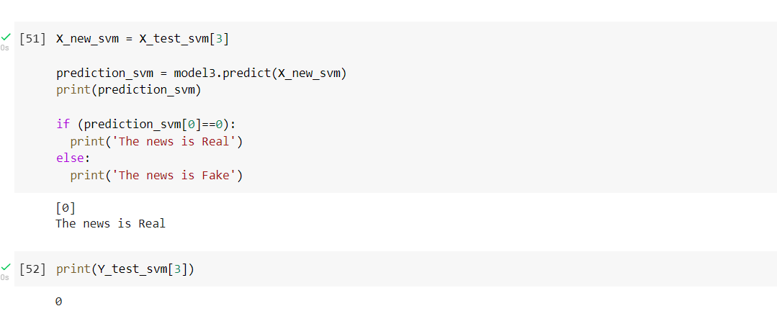
Here we can see we are testing our model with test_data which we divide before.
In test data i am taking third sample and predicting whether it a fake news or not a Real news
We can see the output in the screen shot where 3rd sample predicted as real news.

Slide 25
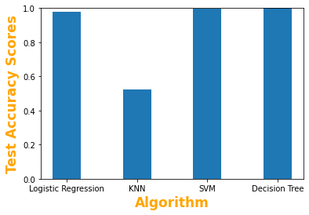
Conclusion:-
When the accuracy score of Logistic Regression, KNN, SVM and Decision Tree are compared, SVM and Decision Tree seems to be overfitted and KNN seems to be under fitted.
So Logistic Regression is the good fit when compared with the other algorithms.

Slide 26
THANK YOU…!!

